Slide 1
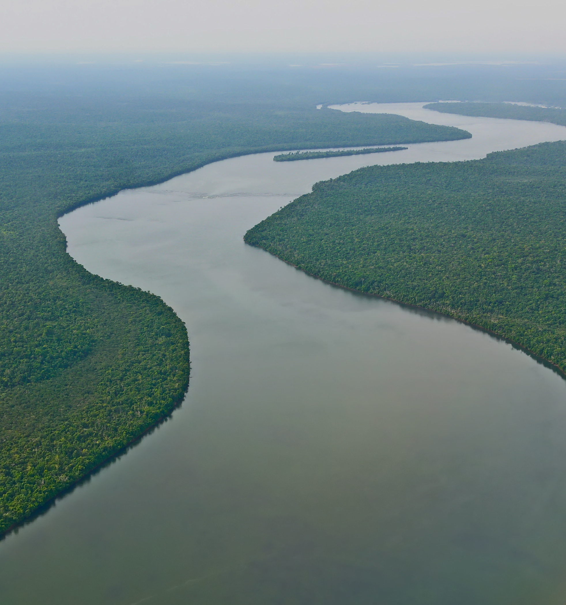


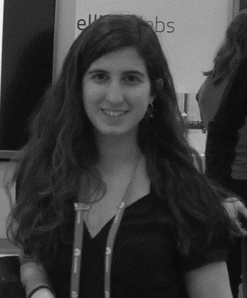


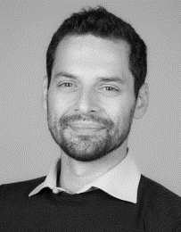

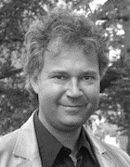
RIVER SEGMENTATION FOR FLOOD MONITORING
LAURA LOPEZ-FUENTES
University of the Balearic Islands
Autonomous University of Barcelona
AnsuR Technologies
Balearic Islands Health Research Institute
CLAUDIO ROSSI
Instituto Superiore Mario Boella
HARALD SKINNEMOEN
AnsuR Technologies

Slide 2
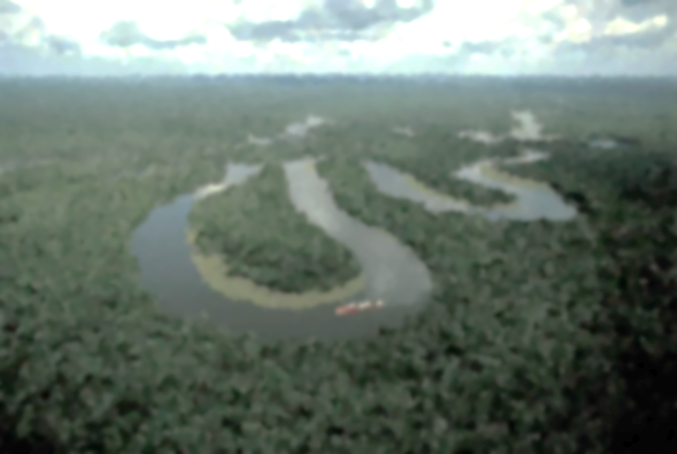
INTRODUCTION AND RELATED WORK
SEMANTIC SEGMENTATION ALGORITHMS
DATASET
EXPERIMENTS
CONCLUSIONS
Notes:
In this presentation I am first going to start by giving an introduction and motivation on how water segmentation in rivers can help to early flood alert. Then I briefly introdice three state-of-the-art semantic segmentation algorithms that have been proposed in the literatura and that we will apply for this task. Then I am going to talk about the dataset that we have created to train the algorithms and test the result, the experiments that we have done and I will finalize with some conclusions.

Slide 3
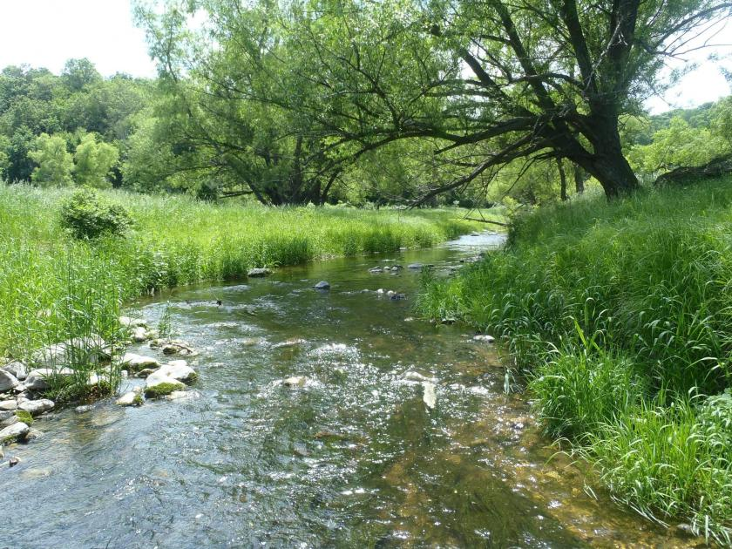

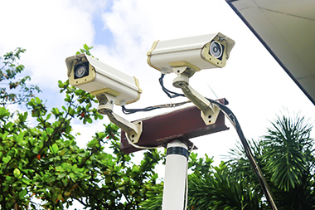
INTRODUCTION
VIDEO CAMERAS FOR RIVER BED MONITORING
Floods report anual economic losses of
96
billion
Notes:
Floods are major natural disasters which cause deaths and material damages every year. Monitoring these events is crucial in order to reduce both the affected people and the economic losses.
Floods report global annual economic losses of $96 billion. They are mainly due to river water overflows, which are caused either by heavy precipitations or by rapid snow melting. Lately, with the decrease in cost of video cameras and to improve river monitoring and early warnings, video cameras can be installed in riverbeds to assess the water level status. The most straightforward way to visually determine if an alert threshold is reached is to use static cameras pointed toward the riverbed and compare the water level against historical observations . However, the manual monitoring of video cameras is very costly. In this work, we propose to use a water segmentation technique to analyze video streams in real-time in order to automatically detect sudden water extend increases.
The idea is that if we have a water segmentation algorithm, we can set up a water level threshold

Slide 4
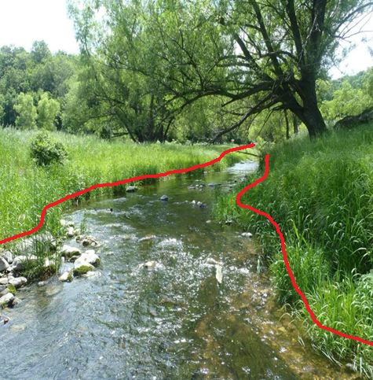
INTRODUCTION
VIDEO CAMERAS FOR RIVER BED MONITORING
Floods report anual economic losses of
96
billion
Notes:
And actívate an alarm when the water level goes above the threshold.

Slide 5
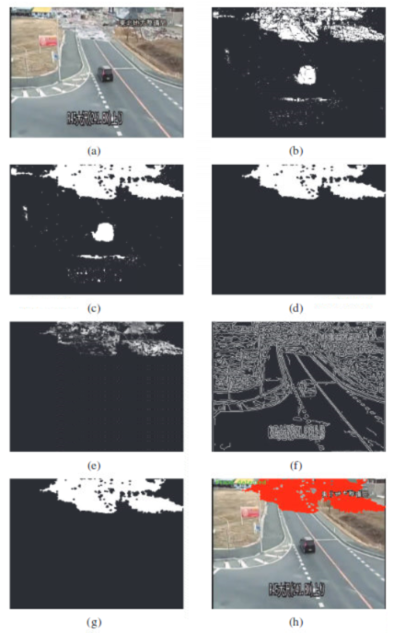
RELATED WORK
Early water detection algorithms:
Morphological operations
Color probability
Light
Texture
Color features
Clustering and classification algorithms
Drawbacks of early water detection algorithms:
Hand-crafted features
Dependent on image characteristics (lighting conditions, water color…)
Difficult to transfer to other problems
No public comparison benchmark dataset
Notes:
The incremental usage of surveillance cameras in areas prone to natural disasters has raised interest in such events in the scientific community, especially in the computer vision
domain. Background subtraction techniques together with morphological operations and color probability has been used to determine water presence in videos. When it
comes to static images, most algorithms are based on light, texture and color features, and on clustering or classification models to segment the regions containing water . The
main drawback of these algorithms is the usage of handcrafted features which work well only the specific context in which they were created, because they are dependent
on image characteristics such as lighting conditions, water color, etc. Moreover, the comparison among such algorithms is difficult because all previous studies are evaluated on nonpublicly-available data.

Slide 6

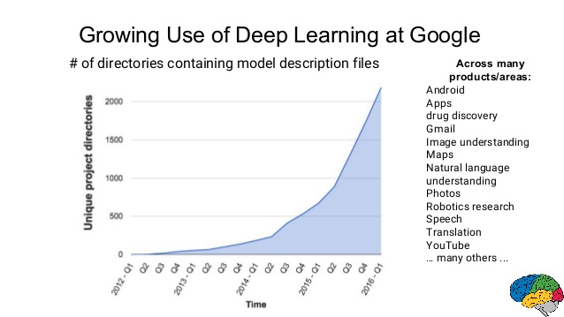
RELATED WORK
Deep Neural Networks (Deep learning)
Notes:
In the last few years, the breakthrough of Deep Learning has stirred the field of machine learning and artificial Intelligence. As an example Google, on of the leading companies in Artificial Intelligence has increased exponentially the usage of Deep Learning in the past 5 years.

Slide 7
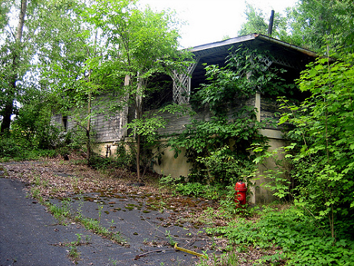
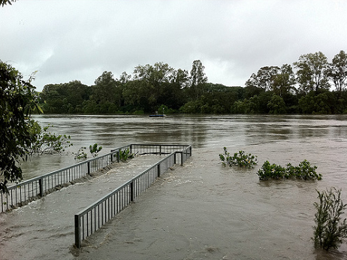
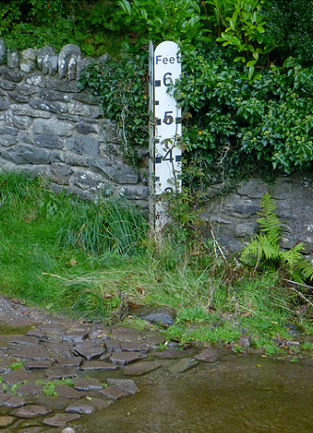
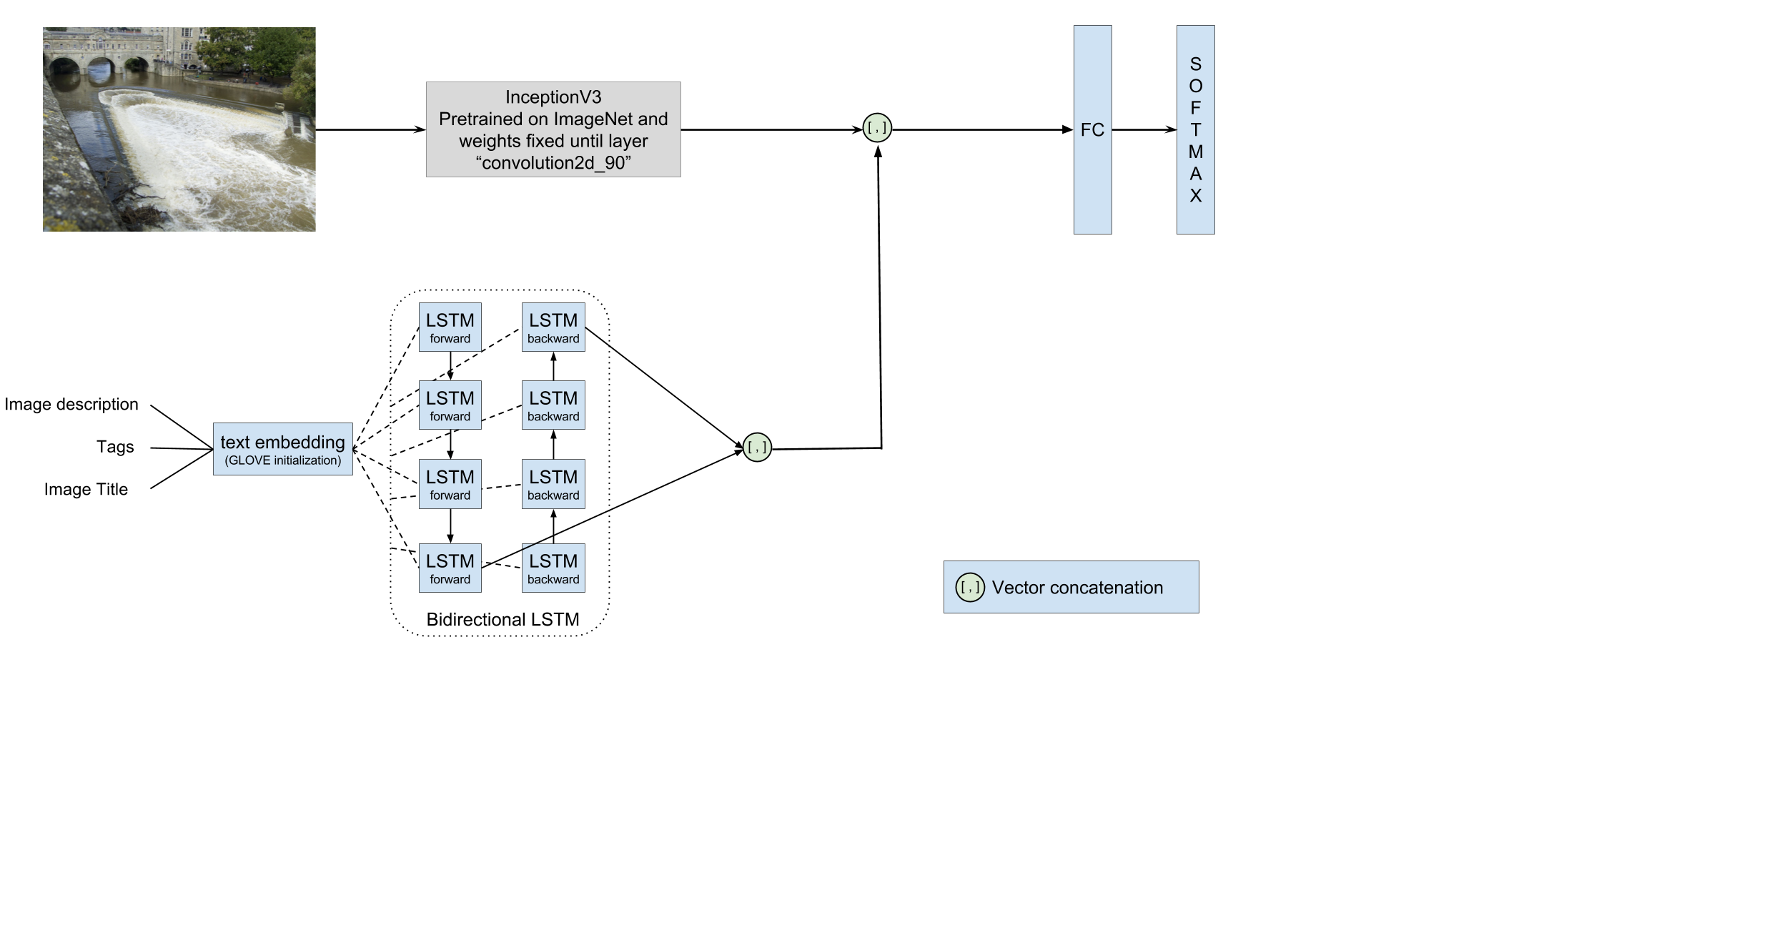
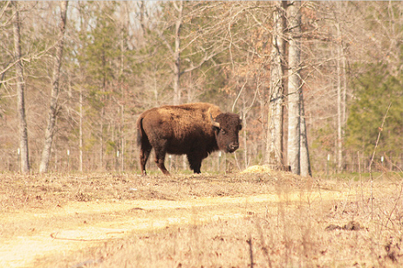
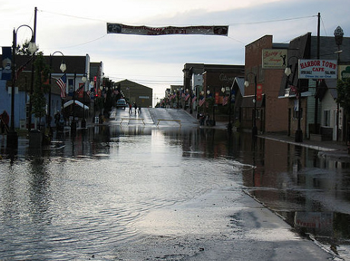
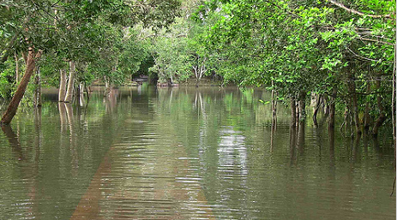
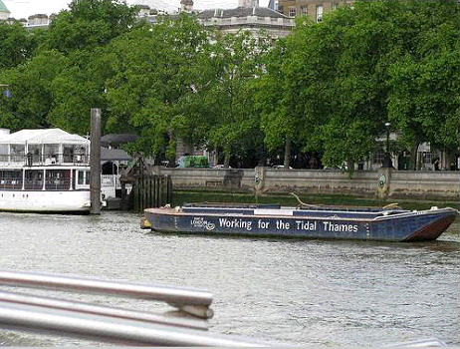
RELATED WORK
Flood detection with Deep learning
Notes:
Deep learning has also recently been applyed to flood estimation in images and video. Specifically we refer to a paper where they designed a convolutional neural network to detect

Slide 8
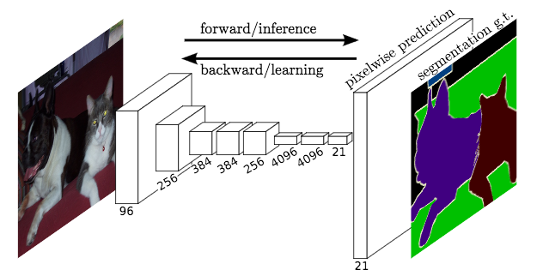
SEMANTIC SEGMENTATION ALGORITHMS
Fully convolutional networks for semantic segmentation (FCN-8s):
Adapt contemporary classification networks into fully convolutional network.
Bilinear interpolation and upsampling to reverse forward and backward passes of the convolution.
Skip layers are added to combine the prediction layer with previous layers with finer strides.
Notes:
One of the first proposed FCN for
semantic segmentation, adapting contemporary classification
networks such as AlexNet [17], VGGnet [18] and
GoogLeNet [19] into FCN. To produce dense predictions
they propose to do bilinear interpolation and upsampling
using convolutions with an input stride of 1=f, where f
is the factor needed in order to reverse the forward and
backward passes of the convolution. The deconvolutional
filters are also learned. Skip layers are added to combine
the prediction layer with previous layers with finer strides

Slide 9
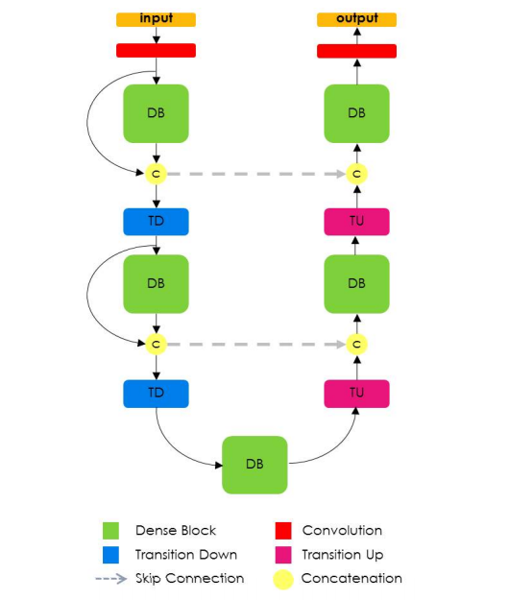
SEMANTIC SEGMENTATION ALGORITHMS
Fully convolutional DenseNets for semantic segmentation (Tiramisu):
Adapt DenseNet classification networks into fully convolutional network.
Built from a series of dense blocks that are iterative concatenations of previous feature maps, thus introducing skip connections and multi-scale supervision.
Introduce upsampling operations to recover the image resolution.

Slide 10
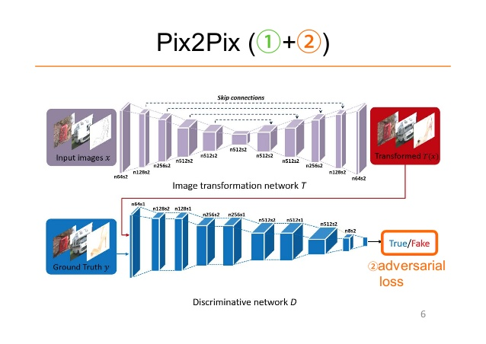
SEMANTIC SEGMENTATION ALGORITHMS
Image-to-Image Translation with Conditional Adversarial Networks (pix2pix)
It learns to map an input image to an output image and the loss of the mapping.
Does not rely on manually fixed loss.
Applied to multiple tasks.
The network is composed of a Generator that produces the output image and a Discriminator which learns to distinguish between the images generated by G and the “real” ones.
Use skip connections to recover the image resolution.

Slide 11
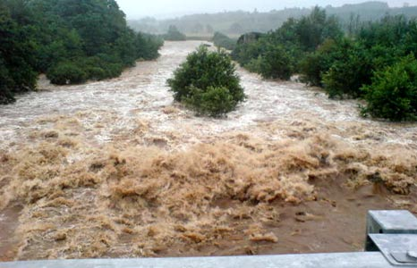
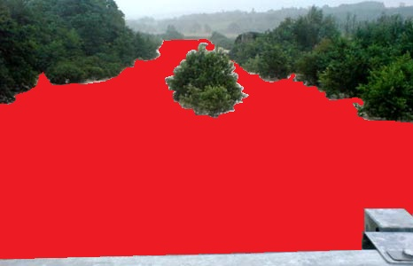
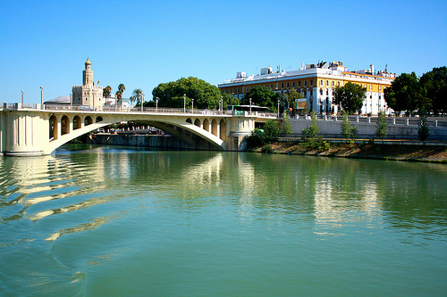
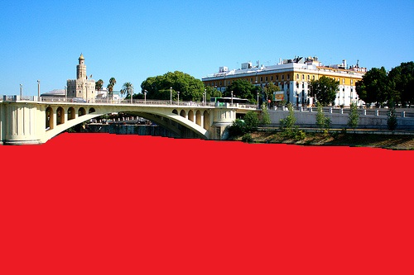
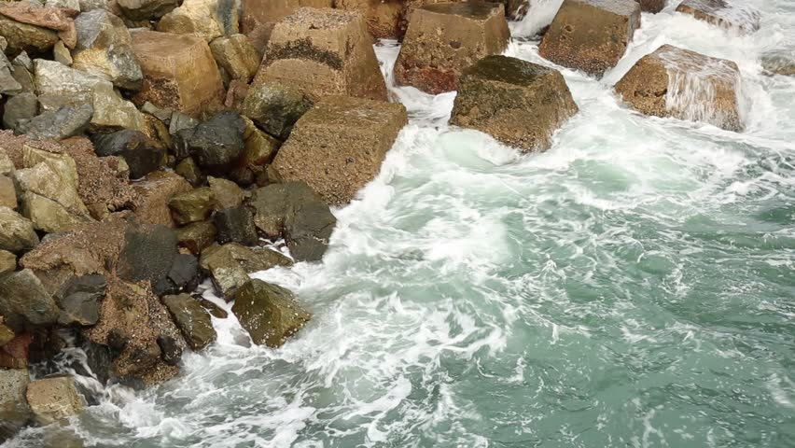
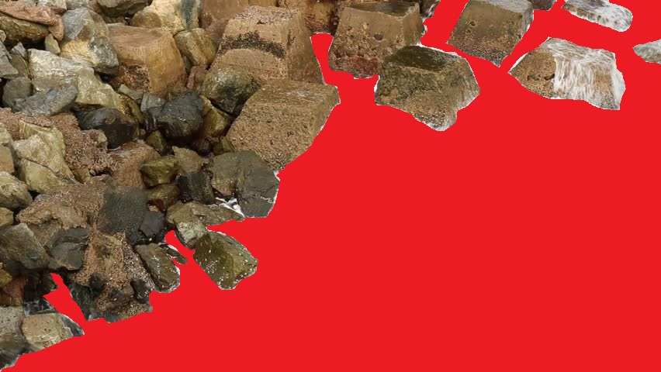
DATASET
River water segmentation dataset
Num. images | 300
Biggest image | 2448x3264 pixels
Smallest image | 118x158 pixels
Mean size of image | 550x826 pixels
Min percentage of water | 6.31%
Max percentage of water | 91.37%
Mean percentage of water | 39.57

Slide 12



EXPERIMENTS
Segmentation metrics:
Where:
$n_{ij}$ is the number of pixels of class $i$ which has been wrongly classified as belonging to class $j$
$n_{ii}$ represents the number of pixels of class $i$ which have been correctly classified
$C$ is the total number of classes
$t_{i}$ is the total number of pixels of class $i$
$$MIoU=\frac{\left(1/C\right)\sum_{i}{n_{ii}}}{t_{i}+ \sum_{j}{n_{ji} − n_{ii}}}$$
$$Pa= \frac{\sum_{i}{n_{ii}}}{\sum_{i}{t_{i}}}$$

Slide 13
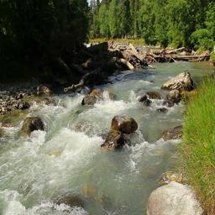
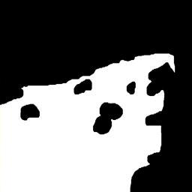
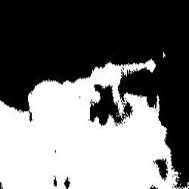
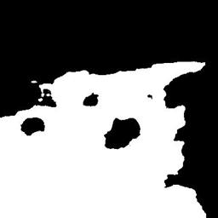
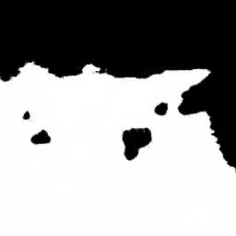
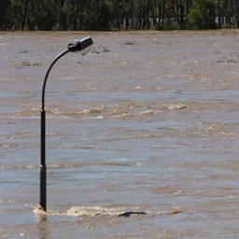
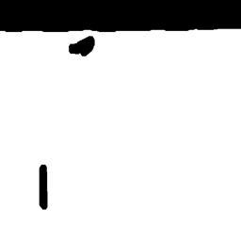
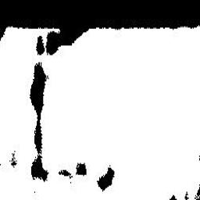

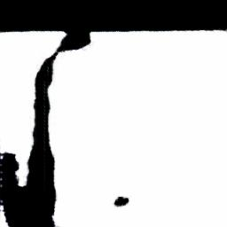
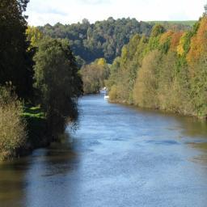
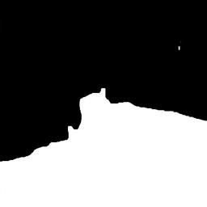
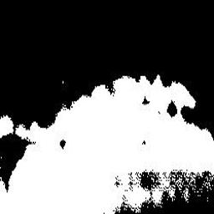
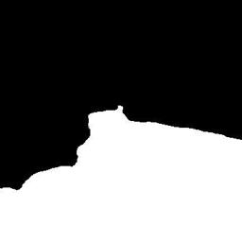
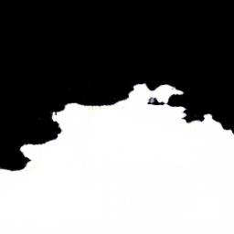
EXPERIMENTS
 | MIoU (%) |  | Pa (%)
 | Mean | Std | Mean | Std
FCN-8s | 70.05 | 14.92 | 82.80 | 11.04
Tiramisu | 81.91 | 13.74 | 90.47 | 9.16
Pix2Pix | 72.25 | 14.27 | 84.70 | 10.05
 | Number of images
 | MIoU |  | Pa
 | Worst | Best | Worst | Best
FCN-8s | 37 | 6 | 37 | 7
Tiramisu | 10 | 57 | 11 | 57
Pix2Pix | 28 | 12 | 27 | 12
Original
Gt
FCN-8s
Tiramisu
Pix2Pix

Slide 14
CONCLUSIONS
We have:
Studied 3 state-of-the-art semantic segmentation algorithms
Applied them to water segmentation from rivers
Introduced a new dataset for water segmentation
Concluded that the Tiramisu algorithm perfoms best for river water segmentation
Thank you!
Any questions?

